Slide 1
Formal techniques for Neuro-Symbolic Modeling Lecture 5
Kyle Richardson and Vivek Srikumar

Slide 2
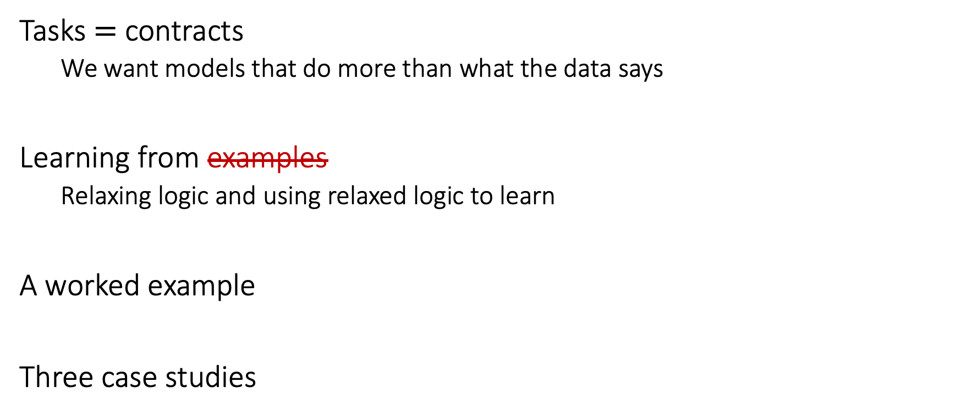
This lecture
Tasks $=$ contracts
We want models that do more than what the data says
Learning from examples
Relaxing logic and using relaxed logic to learn
A worked example
Three case studies
Knowledge

Slide 3
Tasks = contracts
We want models that do more than what the data says

Slide 4
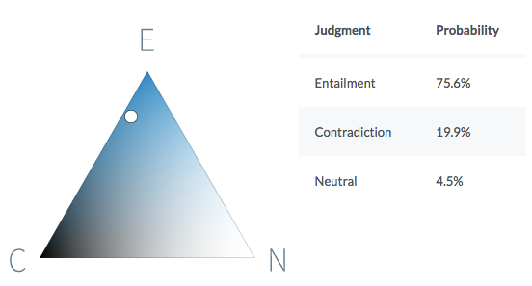
Example 1: Natural language inference
Premise
Before it moved to Chicago, aerospace manufacturer Boeing was the largest company in Seattle.
Hypothesis
Boeing is a Chicago-based aerospace manufacturer.
It is quite likely that the premise entails the hypothesis.
https://demo.allennlp.org/textual-entailment/

Slide 5
Can neural networks understand text?
Example 1: Natural language inference
P John is on a train to Berlin.
H John is traveling to Berlin.
Z John is having lunch in Berlin.
P
No relationship?
Entails
H
Z
Contradicts
The same system cannot simultaneously hold these three beliefs!
Violates this invariant
If P entails H and H contradicts Z,
then P contradicts Z
Can neural networks use such “theory” in the form of invariant knowledge?
A BERT-based model that gets ~90% on benchmark data violates this invariant on 46% of a large collection of sentence triples.

Slide 6
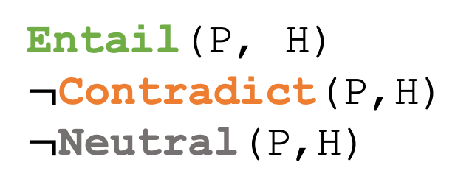
Tasks* define predicates
Example: The natural language inference task defines three predicates called Entail(P,H), Contradict(P,H) and Neutral(P,H)
P John is on a train to Berlin.
H John is traveling to Berlin.
Entail(P, H)
$¬$Contradict(P,H)
$¬$Neutral(P,H)
Labeled datasets show examples of these predicates
Models try to find the best fitting predicates given their arguments
* Tasks that require labeling examples or parts of them

Slide 7
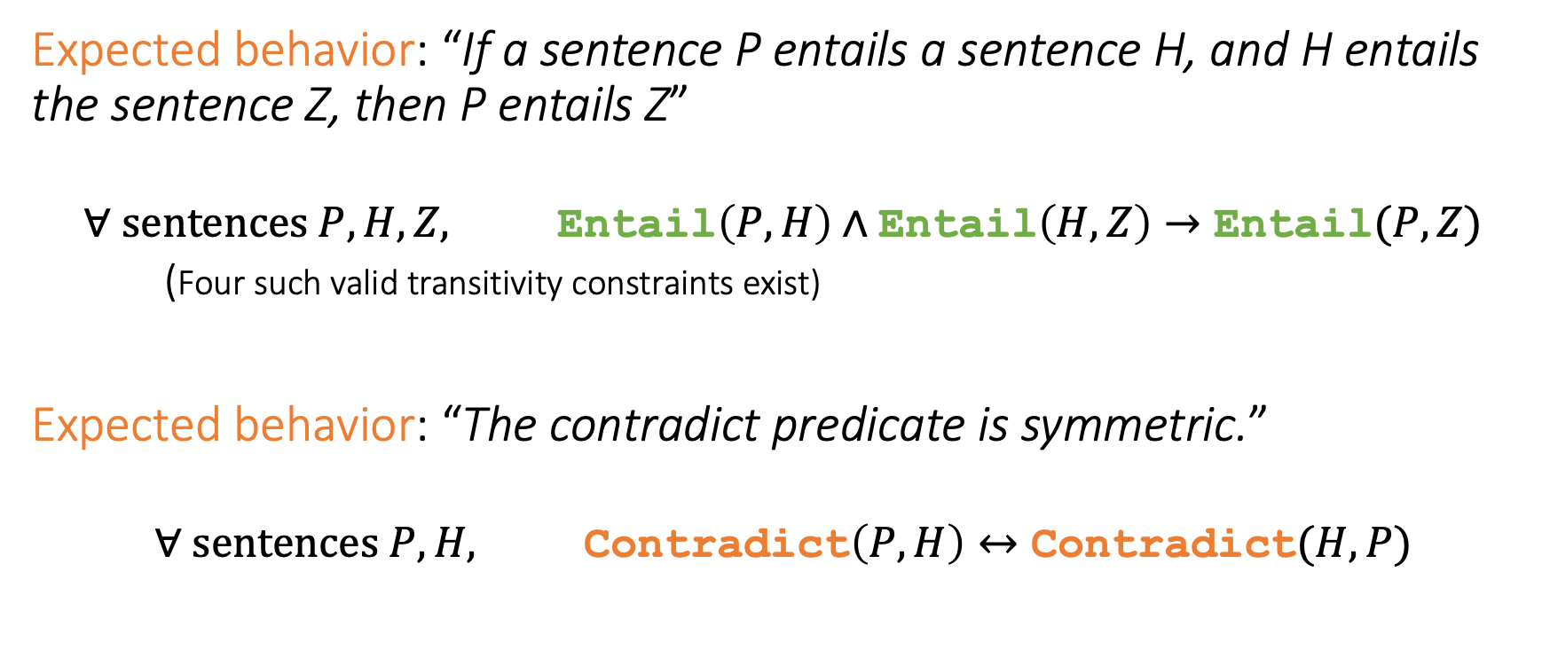
Model behavior as constraints
Example 1: Natural language inference
Expected behavior: “If a sentence P entails a sentence H, and H entails the sentence Z, then P entails Z”
$$∀ \text{sentences} P, H, Z, \text{Entail}\left(P, H\right)∧\text{Entail}\left(H, Z\right)→\text{Entail}(P, Z)$$
(Four such valid transitivity constraints exist)
Expected behavior: “The contradict predicate is symmetric.”
$$∀ \text{sentences} P, H, \text{Contradict}\left(P, H\right)↔\text{Contradict}(H,P)$$
A Logic-Driven Framework for Consistency of Neural Models. Li, Gupta, Mehta and Srikumar. EMNLP, 2019.

Slide 8




Example 2: Semantic Role Labeling (SRL)
Who did what to whom, where, when, why?
The mouse ate the cheese when the farmer left the kitchen.
Arg0
Arg1
ArgM-TMP
Arg1
Arg0
These semantic roles are defined by the PropBank data (Palmer et al)
ate
Arg0 | The mouse
Arg1 | the cheese
ArgM-TMP | when the farmer left the kitchen
left
Arg0 | the farmer
Arg1 | the kitchen

Slide 9
Semantic Role Labeling: The contract
Example 2: Semantic Role Labeling (SRL)
Input: A sentence
Output: Structured semantic frames for all verbs
Expected behavior: Outputs should satisfy certain constraints
Core arguments (e.g. Arg0, Arg1) cannot repeat…
…but modifiers (e.g. ArgM-TMP) can
Certain arguments (called references, e.g. R-Arg0) can appear only if the corresponding referent argument exists (here, Arg0)
These symbolic constraints come from the task definition and linguistic assumptions

Slide 10
If labels satisfy symbolic properties…
Tasks = Contracts
…when and how do we inject this knowledge into the modeling and prediction process?
Can we do so using the existing gradient-based machinery for neural networks?

Slide 11
Learning from examples
knowledge
Relaxing logic and using relaxed logic to learn

Slide 12
Where can knowledge be involved?
Model design
Loss function design & training
Enforce congruent predictions
Augmenting neural networks with logic (ACL 2019)
Logic-based loss design (EMNLP 2019,
ACL 2020, IJCAI 2021)
Structured learning & prediction
Model counting covered in lecture 3
Covered in lecture 4
This section of the tutorial

Slide 13
Neural network land vs. Logic land
Neural Networks
✓Differentiable compute, easy to use
✗ Hard to supervise except via labeled examples
First-order logic
✗ Not differentiable, hard to use with today’s best infrastructure
✓ Expressive and easy to state for domain experts
What we want: Best of both!

Slide 14
Three challenges facing logic in neural network land
Bridging predicates in rules with neural networks
Making logic differentiable
Using differentiable logic

Slide 15
Predicates in neural networks
All neural networks expose interfaces in the form of nodes that have externally defined meaning

Slide 16
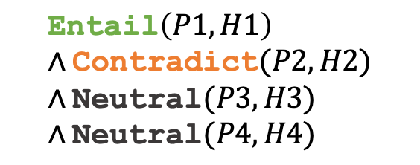
Recall: Labels are predicates
Entail
P John is on a train to Berlin.
H John is traveling to Berlin.
BERT
=
Entail(P, H)
P,H
Labeled datasets are formal specifications
(P1, H1, Entail)
(P2, H2, Contradict)
(P3, H3, Neutral)
(P4, H4, Neutral)
$$\text{Entail}\left(P1, H1\right)∧\text{Contradict}(P2, H2)∧\text{Neutral}(P3, H3)∧\text{Neutral}(P4, H4)$$
=

Slide 17

Predicates within neural networks
Premise
Some internal nodes in the network may have meaning by design
Example: The decomposable attention model [Parikh et al 2016] models alignments between premise and hypothesis words as attention
John is on a train to Berlin.
Encode
Predict
Attention
$$\text{Entail}$$
Encode
Align(train, traveling)
John is traveling to Berlin.
Hypothesis
Parikh, Täckström, Das, and Uszkoreit. "A Decomposable Attention Model for Natural Language Inference." In EMNLP 2016

Slide 18
Named neurons
Nodes in a computation graph that have externally defined meaning
Named neurons can be:
Any output nodes in the network
Inputs to the network and their deterministic properties
Sometimes, internal nodes that have defined behavior
Named neurons give us the vocabulary for writing rules

Slide 19
Three challenges facing logic in neural network land
Bridging predicates in rules with neural networks?
Answer: Named neurons, nodes in a computation graph that have externally defined meaning
Making logic differentiable?
Using differentiable logic?

Slide 20
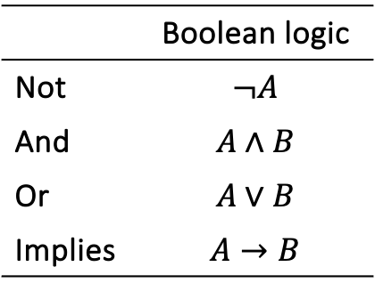
Relaxing Boolean operators
Triangular norms provide systematic relaxations of logic
Some are continuous and sub-differentiable
Inputs, outputs live in {0,1}
 | Boolean logic
Not | $$¬A$$
And | $$A∧B$$
Or | $$A∨B$$
Implies | $$A→B$$
Klement, Erich Peter, Radko Mesiar, and Endre Pap. Triangular norms. Vol. 8. 2013.

Slide 21
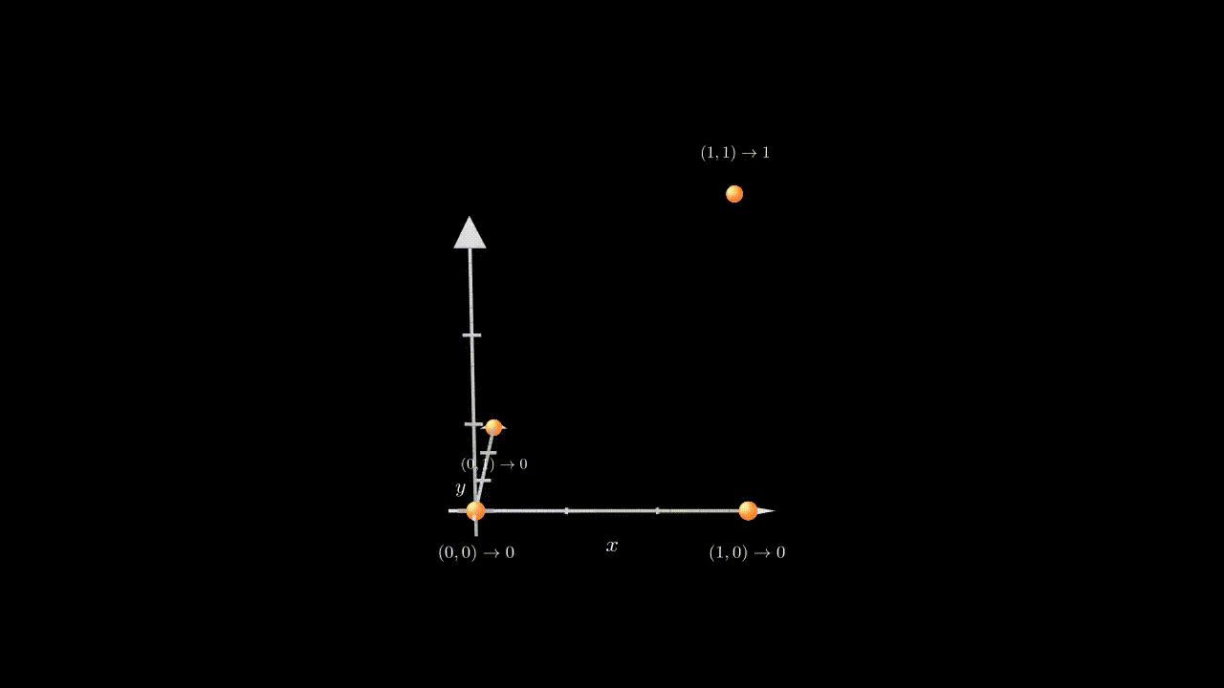
Relaxing the Boolean conjunction

Slide 22
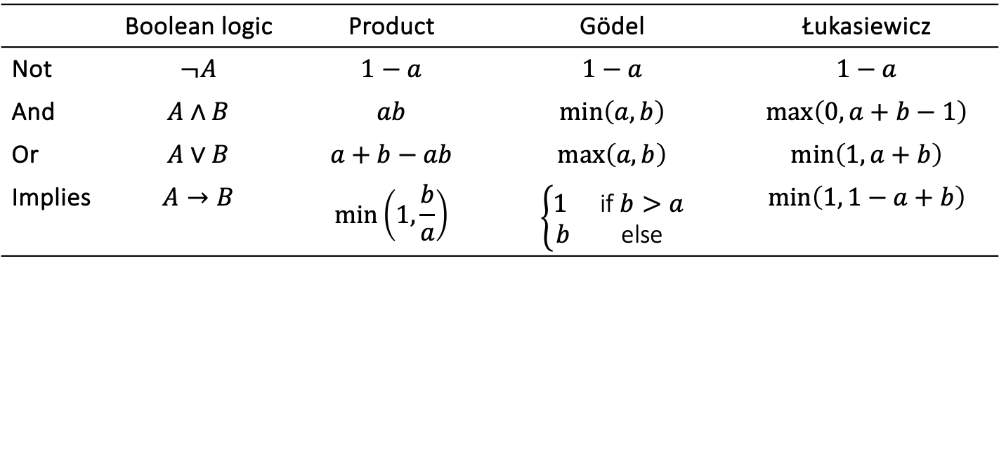
Relaxing Boolean operators
Triangular norms provide systematic relaxations of logic
Some are continuous and sub-differentiable
Inputs, outputs live in {0,1}
Inputs, outputs live in [0,1]
 | Boolean logic | Product | Gödel | Łukasiewicz
Not | $$¬A$$ | $$1−a$$ | $$1−a$$ | $$1−a$$
And | $$A∧B$$ | $$ab$$ | $$\min\left(a,b\right)$$ | $$\max\left(0, a+b−1\right)$$
Or | $$A∨B$$ | $$a+b−ab$$ | $$\max\left(a, b\right)$$ | $$\min\left(1, a+b\right)$$
Implies | $$A→B$$ | $$\min\left(1,\frac{b}{a}\right)$$ | $$\left\{\begin{matrix}1 & \text{if} b>a \\ b & \text{else}\end{matrix}\right.$$ | $$\min\left(1, 1−a+b\right)$$
Klement, Erich Peter, Radko Mesiar, and Endre Pap. Triangular norms. Vol. 8. 2013.

Slide 23
Three challenges facing logic in neural network land
Bridging predicates in rules with neural networks?
Answer: Named neurons, nodes in a computation graph that have externally defined meaning
Making logic differentiable?
Answer: Use a t-norm relaxation
Using differentiable logic?

Slide 24
What logic can do for neural networks?
Introduce inductive bias by…
…changing network architecture
to networks that prefer satisfying the constraints
…by regularizing learning
to penalize models that violate the constraints

Slide 25
What relaxed logic can do for neural networks?
Introduce inductive bias by…
…changing network architecture
to networks that prefer satisfying the constraints
…by regularizing learning
to penalize models that violate the constraints
Augmenting Neural Networks with First-order Logic. Li and Srikumar. ACL 2019.

Slide 26
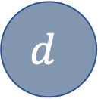
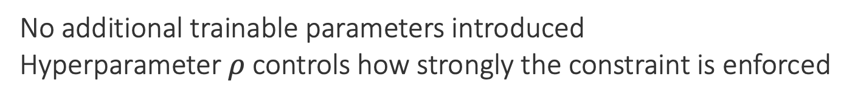
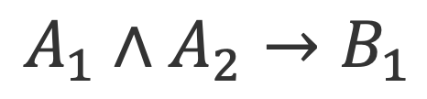
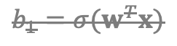
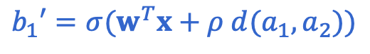
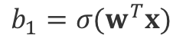
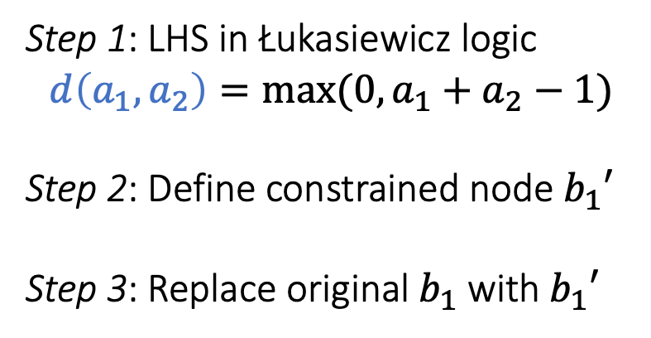
Augmenting models: An example
$$b_{1}′=σ(w^{T}x+ρ d(a_{1},a_{2}))$$
$$A_{1}∧A_{2}→B_{1}$$
$$b_{1}=σ(w^{T}x)$$
$$b_{1}=σ(w^{T}x)$$
$$b_{1}$$
$$b_{1}′$$
$$b_{2}$$
$$b_{2}$$
Step 1: LHS in Łukasiewicz logic
$$d\left(a_{1},a_{2}\right)=max⁡(0, a_{1}+a_{2}−1)$$
Step 2: Define constrained node $b_{1}′$
Step 3: Replace original $b_{1}$ with $b_{1}′$
$$d$$
Possibly many layers
$$a_{1}$$
$$a_{2}$$
$$a_{3}$$
No additional trainable parameters introduced
Hyperparameter $ρ$controls how strongly the constraint is enforced

Slide 27
What logic can do for neural networks?
Introduce inductive bias by…
…changing network architecture
to networks that prefer satisfying the constraints
…by regularizing learning
to penalize models that violate the constraints
A Logic-Driven Framework for Consistency of Neural Models. Li, Gupta, Mehta and Srikumar. EMNLP, 2019.
Structured Tuning for Semantic Role Labeling. Li, Jawale, Palmer and Srikumar. ACL, 2020.
Evaluating Relaxations of Logic for Neural Networks: A Comprehensive Study. Medina-Grespan, Gupta, Srikumar. IJCAI 2021.
Logic-driven Indirect Supervision: An Application to Crisis Counseling. Medina-Grespan et al, ACL 2023

Slide 28
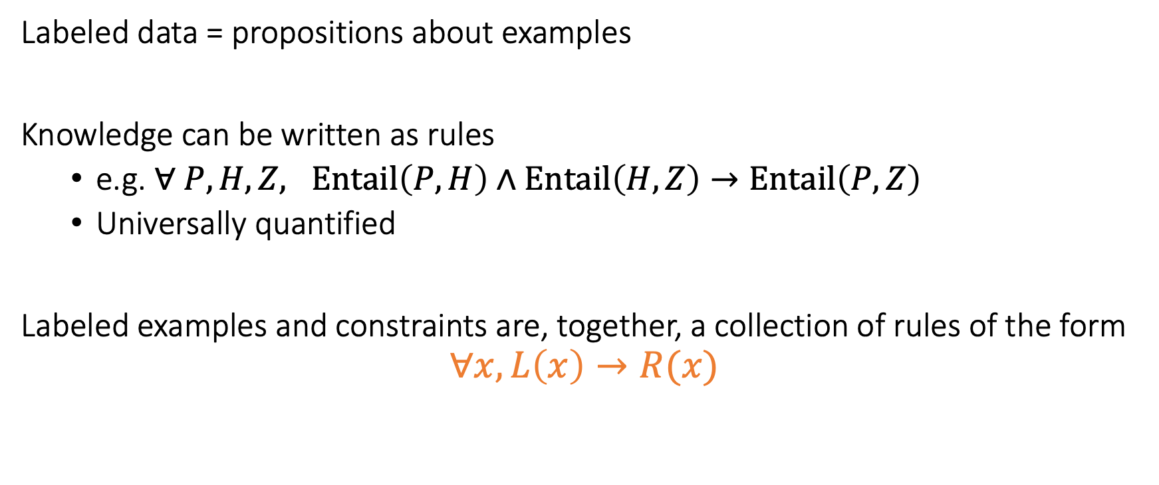
Unifying data & knowledge
Labeled data = propositions about examples
Knowledge can be written as rules
e.g. $∀ P, H, Z, Entail\left(P,H\right)∧Entail\left(H, Z\right)→Entail\left(P, Z\right)$
Universally quantified
Labeled examples and constraints are, together, a collection of rules of the form
$$∀x, L\left(x\right)→R(x)$$

Slide 29
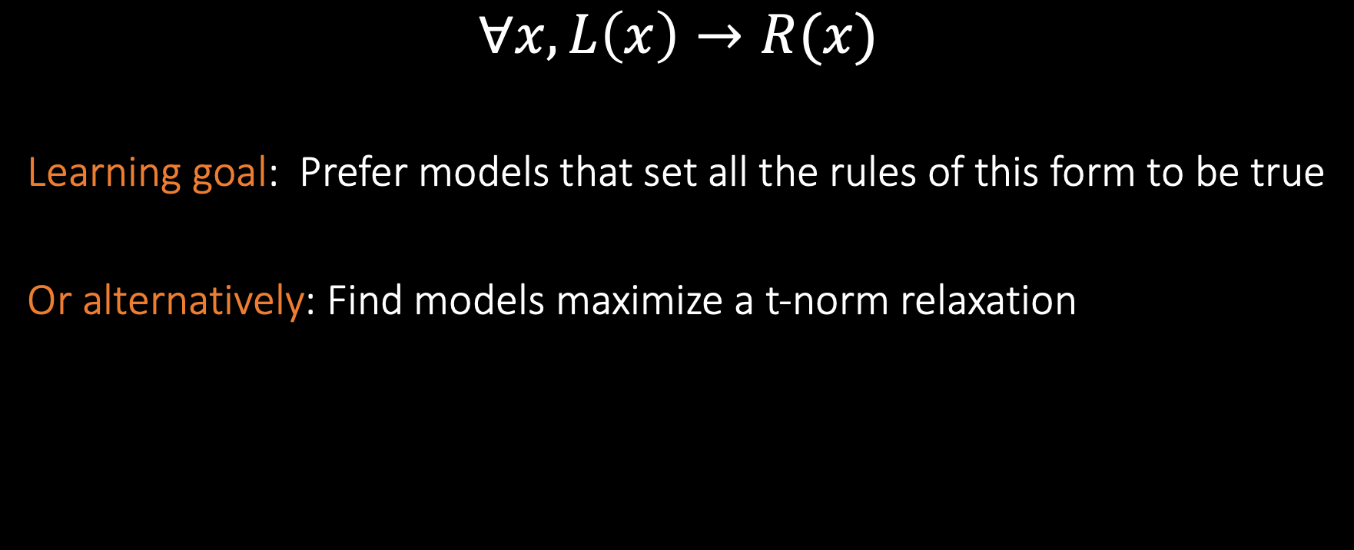
Encouraging consistency of models
$$∀x, L\left(x\right)→R(x)$$
Learning goal: Prefer models that set all the rules of this form to be true
Or alternatively: Find models maximize a t-norm relaxation
Labeled data + knowledge
Inconsistency losses
Use any neural model, any library and any optimizer
Product t-norm + labeled examples gives cross entropy loss

Slide 30
Worked example
Multiclass classification + product t-norm = cross-entropy loss

Slide 31
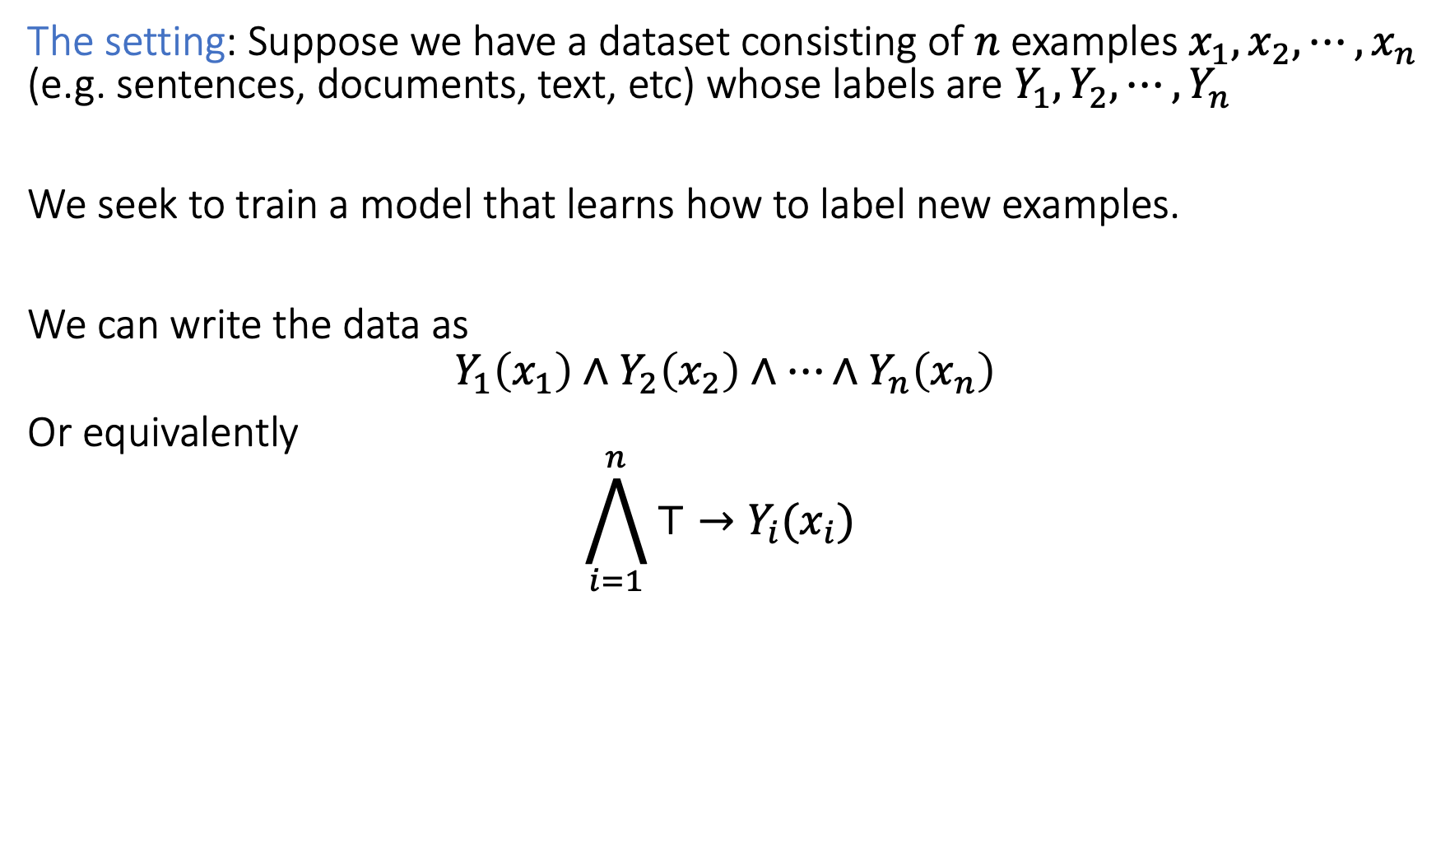
Multiclass classification
The setting: Suppose we have a dataset consisting of $n$ examples $x_{1}, x_{2},⋯, x_{n}$ (e.g. sentences, documents, text, etc) whose labels are $Y_{1},Y_{2},⋯, Y_{n}$
We seek to train a model that learns how to label new examples.
We can write the data as
$$Y_{1}\left(x_{1}\right)∧Y_{2}\left(x_{2}\right)∧⋯∧Y_{n}\left(x_{n}\right)$$
Or equivalently
$$\bigwedge_{i=1}^{n}{⊤→Y_{i}(x_{i})}$$

Slide 32
How to relax logical formulas for learning models
Pick a t-norm
Replace predicates with model probabilities (unless they can be deterministically computed)
Recursively replace the Boolean operations
(For numerical reasons: Take the logarithm of the final expression)

Slide 33
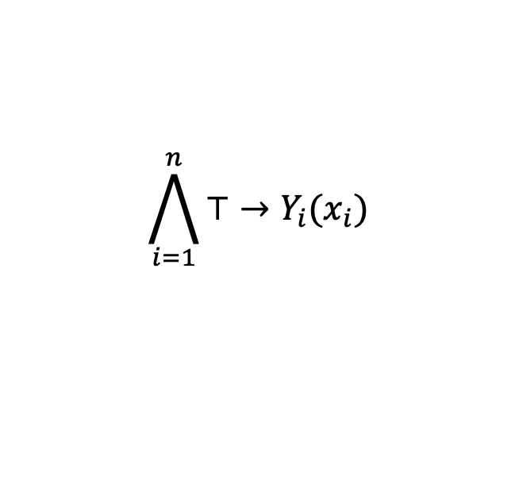
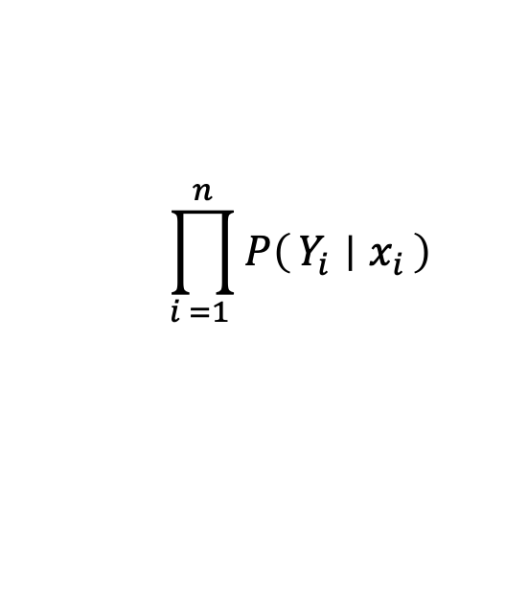
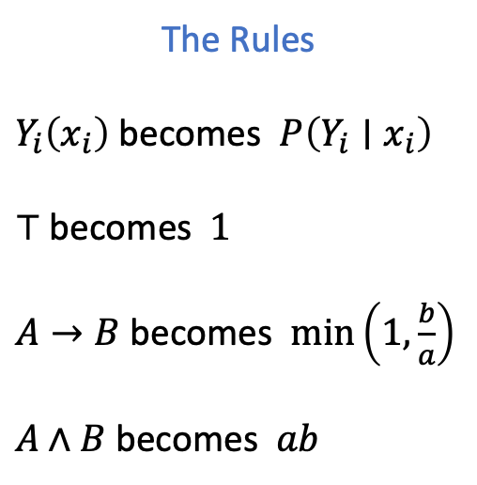
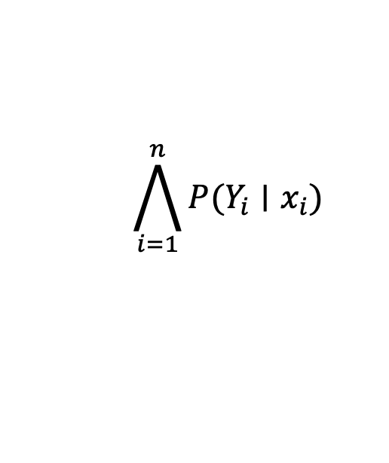
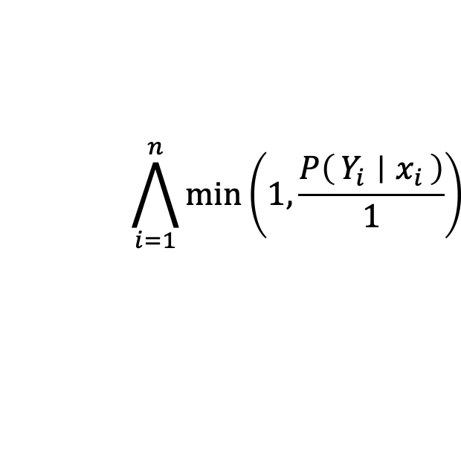
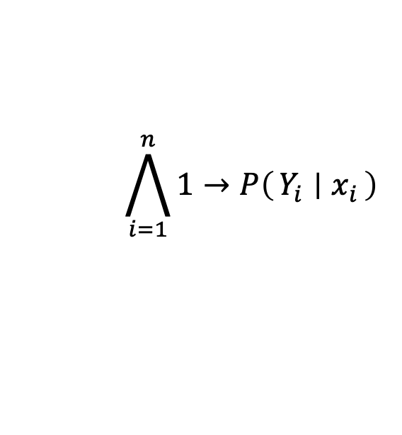
Relaxing using the product t-norm
The Rules
$Y_{i}\left(x_{i}\right)$becomes $P\left(Y_{i}∣x_{i}\right)$
$⊤$becomes $1$
$A→B$becomes $\min\left(1,\frac{b}{a}\right)$
$A∧B$becomes $ab$
$$\bigwedge_{i=1}^{n}{⊤→Y_{i}(x_{i})}$$
$$\bigwedge_{i=1}^{n}{1→P\left(Y_{i} ∣ x_{i}\right)}$$
Not syntactically valid yet
$$\bigwedge_{i=1}^{n}{P(Y_{i}∣x_{i})}$$
$$\bigwedge_{i=1}^{n}{\min\left(1,\frac{P\left(Y_{i} ∣ x_{i}\right)}{1}\right)}$$
Not syntactically valid yet
$$\prod_{i =1 }^{n}{P\left(Y_{i} ∣ x_{i}\right)}$$
The final relaxation

Slide 34
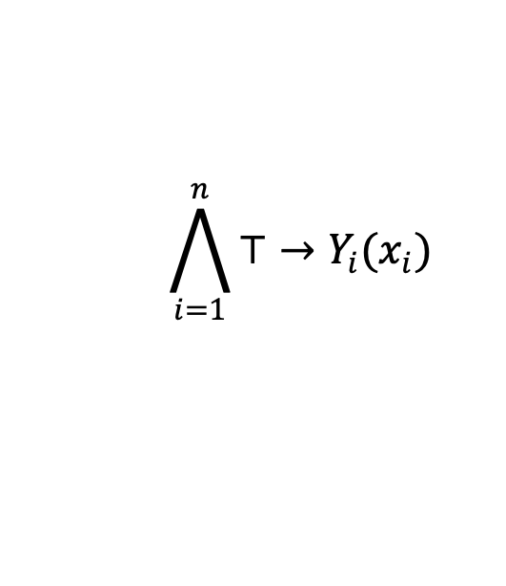
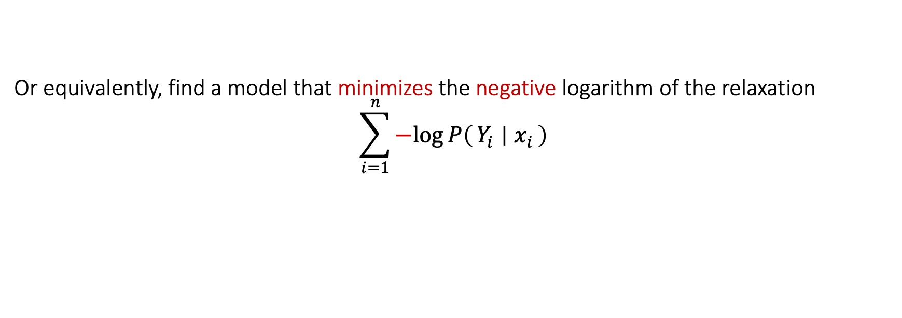
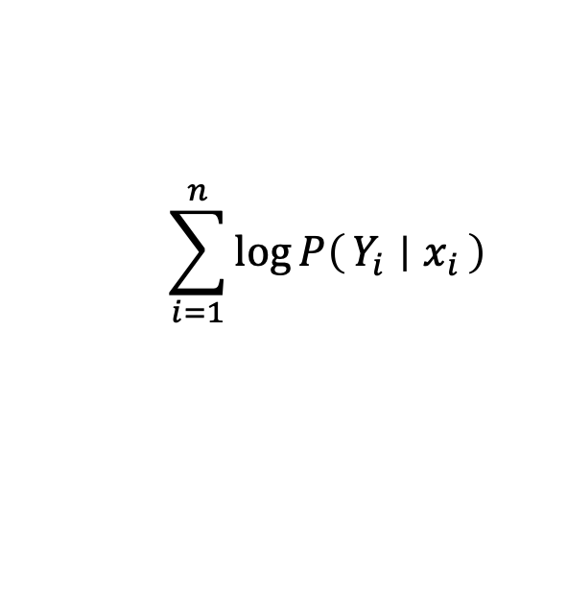
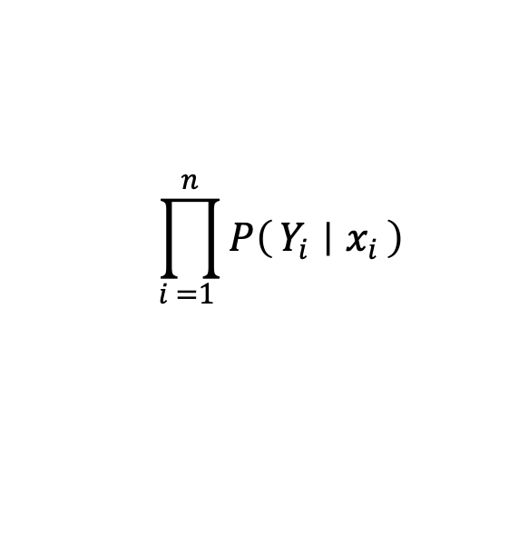
Back to multiclass classification
$$\bigwedge_{i=1}^{n}{⊤→Y_{i}(x_{i})}$$
$$\prod_{i =1 }^{n}{P\left(Y_{i} ∣ x_{i}\right)}$$
The dataset:
Its relaxation:
Our goal: to find a model that tries to make this formula hold
A more reachable goal: to make its relaxation more probable
Or equivalently, find a model that maximizes the logarithm of the relaxation
$$\sum_{i=1}^{n}{\log{P\left(Y_{i} ∣ x_{i}\right)}}$$
Or equivalently, find a model that minimizes the negative logarithm of the relaxation
$$\sum_{i=1}^{n}{−log{P\left(Y_{i} ∣ x_{i}\right)}}$$
This is the popular cross-entropy loss

Slide 35
Case studies

Slide 36
Natural Language Inference
Case Study 1: Augmenting a network [ACL 2019]
SNLI dataset, decomposable attention model [Parikh et al 2016]
Two constraints (written in logic):
If two words are related, they should be aligned
If no content word in the hypothesis is aligned,
then the label cannot be Entail
Augmenting Neural Networks with First-order Logic. Li and Srikumar. ACL 2019.

Slide 37
Results: Natural Language Inference
Case Study 1: Augmenting a network [ACL 2019]
1. Constraints help
2. Larger improvements if training data is limited
3. With 0.5M data, constraints don’t seem to help
Have very large dataset? Just believe the data.

Slide 38

Inconsistency of natural language inference
Case study 2: Regularizing learning
BERT based models for SNLI & MultiNLI datasets
Two kinds of regularizers from constraints:
Symmetry constraint:
$$∀P, H, Contradict\left(P,H\right)↔Contradict(H, P)$$
Four transitivity constraints of the form
$$Entail\left(P,H\right)∧Entail\left(H, Z\right)→Entail\left(P, Z\right)$$
A Logic-Driven Framework for Consistency of Neural Models. Li, Gupta, Mehta and Srikumar. EMNLP, 2019.

Slide 39
Results: Inconsistency of natural language inference
Case study 2: Regularizing learning
Inconsistency represents violation of constraints. Lower is better.
1. Merely adding more data does not make models consistent
2. Logic-based regularizers help with consistency

Slide 40
A common design of neural SRL models
Case study 3: Semantic Role Labeling
There is usually a CRF layer across these label predictions to introduce sequential dependencies between labels
A BIO classifier over the token and verb (a small neural network)
Arg0
Arg1
ArgM-TMP
B-A0
I-A0
V
B-A1
I-A1
B-AM-TMP
…
I-AM-TMP
Each predicate treated separately. Here we see the predictions for the verb ate.
An encoder network (e.g. BERT) to produce contextual representations
A different commonly seen design involves span-based predictions instead of word-level ones.
The
mouse
ate
the
cheese
when
the
farmer
left
the
kitchen
A representative model: With RoBERTa embeddings, on Wall Street Journal data, we can get ~88% label F-scores

Slide 41
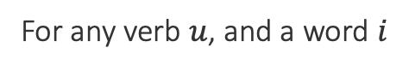
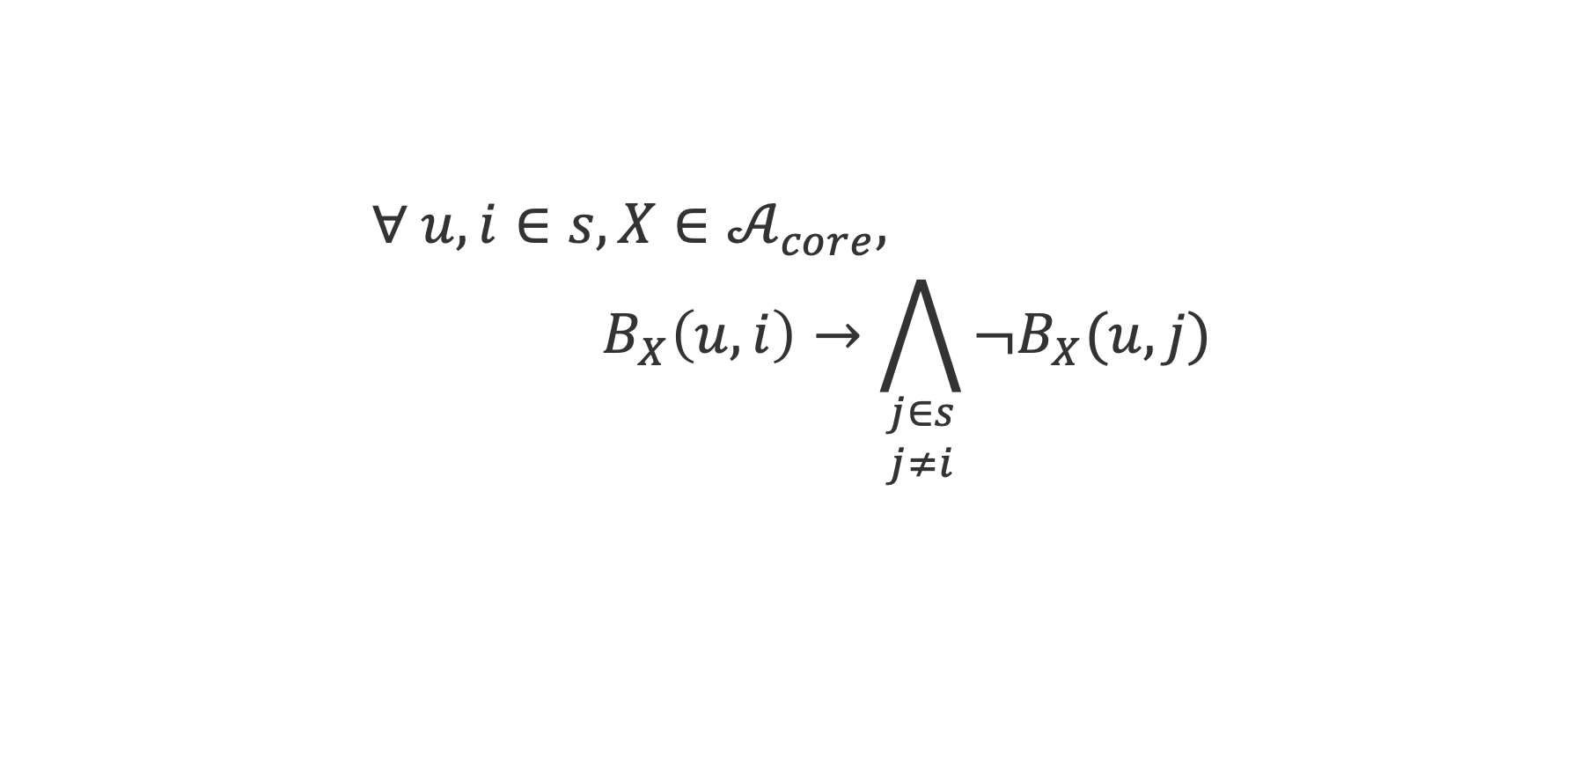
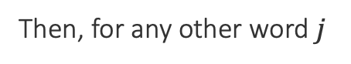
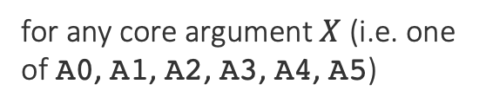
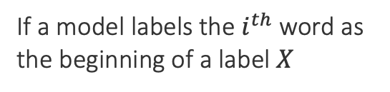
Constraints in SRL: Unique Core Roles
Case study 3: Semantic Role Labeling
Each core argument can occur at most once in the output for a verb
$$∀ u, i∈s, X∈𝒜_{core}, \\ { B}_{X}\left(u, i\right)→\bigwedge_{\begin{aligned}j∈s \\ j≠i\end{aligned}}{¬B_{X}(u, j)}$$
for any core argument $X$ (i.e. one of A0, A1, A2, A3, A4, A5)
For any verb $u$, and a word $i$
The model cannot predict that it is the beginning of the same label
If a model labels the $i^{th}$ word as the beginning of a label $X$
Then, for any other word $j$
Compile into a differentiable expression using a t-norm
Minimize the negative of the expression as part of training
Structured Tuning for Semantic Role Labeling. Li, Jawale, Palmer and Srikumar. ACL, 2020.

Slide 42
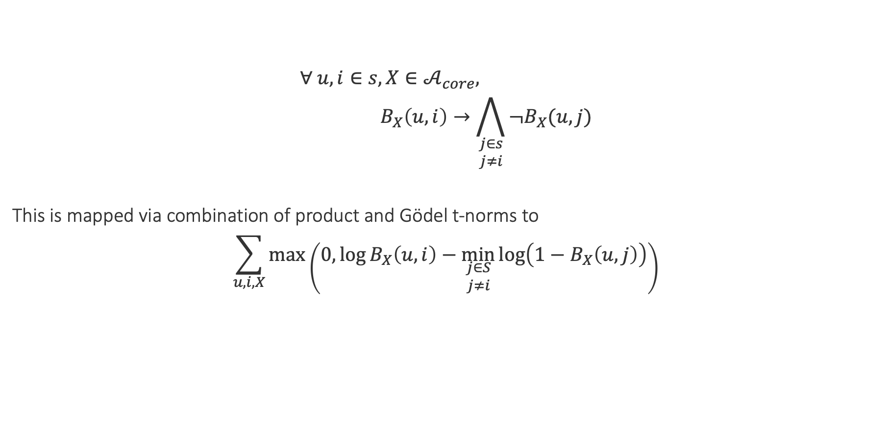
Constraints in SRL: Unique Core Roles
Case study 3: Semantic Role Labeling
$$∀ u, i∈s, X∈𝒜_{core}, \\ { B}_{X}\left(u, i\right)→\bigwedge_{\begin{aligned}j∈s \\ j≠i\end{aligned}}{¬B_{X}(u, j)}$$
This is mapped via combination of product and Gödel t-norms to
$$\sum_{u, i, X}{\max\left(0,\log{B_{X}\left(u,i\right)}−\min_{\begin{aligned}j∈S \\ j≠i\end{aligned}}{\log\left(1−B_{X}\left(u, j\right)\right)}\right)}$$
Model probabilities for this label
Whenever the model assigns high probabilities to invalid outputs, the loss will be high.
(Conversion details in the paper)

Slide 43
Other constraints (informally)
Case study 3: Semantic Role Labeling
Both compiled to losses
The exclusively overlapping role constraint:
In any sentence, an argument for a predicate can either be contained in, or fully outside, the argument for any predicate
The frame core role constraint
A verb can have only those core arguments that are defined in PropBank
✓
✓
✗

Slide 44
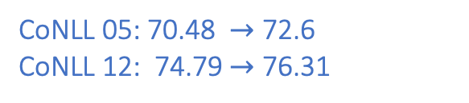
Scenario 1: The low data regime
Case study 3: Semantic Role Labeling
Train with 3% data with and without constraints
Constraints greatly improve precision in the low data regime over the strong RoBERTa baseline
Constraint violations reduced, especially for unique core roles and the frame constraints
CoNLL 05: 1.1k examples
CoNLL 12: 2.7k examples
CoNLL 05: 70.48 $→$ 72.6
CoNLL 12: 74.79 $→$ 76.31
F-scores also improve (paper has details)

Slide 45
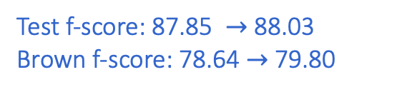
Scenario 2: More training data
Case study 3: Semantic Role Labeling
Train with the full CoNLL 05 data
Surprisingly still better in terms of precision, recall and f-scores, though the margin is lower
Strong out of domain performance on Brown corpus data
Constraint violations reduced for unique core roles and the frame constraints
The unconstrained model doesn’t seem to violate the exclusive overlap constraint!
CoNLL 05: 35k examples, 91k propositions
Test f-score: 87.85 $→$ 88.03
Brown f-score: 78.64 $→$ 79.80

Slide 46

Scenario 3: Even more training data
Case study 3: Semantic Role Labeling
Train with the full CoNLL 12 data
Constrained and unconstrained models are comparable
If you have a lot of data, it is okay to believe the data
CoNLL 12: 90k examples, 253k propositions
Test f-score: 86.4$7→$ 86.61

Slide 47
Knowledge via soft logic helps neural models
Successful experiments across many different tasks
Natural language inference
Question answering
Text chunking
Semantic role labeling
Joint digit recognition and numerical operations over them
Information extraction
Dialogue labeling
General flavor of results
When we have less data, knowledge gives better statistical models
We can “inject” invariances into learned systems…
…which are sometimes not learned, even with lots of data
Check out pylon: A PyTorch Framework for Learning with Constraints (https://pylon-lib.github.io/)

